Slide 1
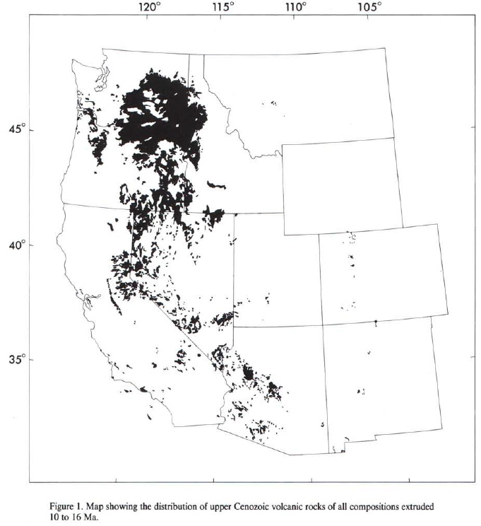
Quaternary volcanism in the western conterminous united states
Luedke & Smith 1991
Geol 730 Presentation By: Neal Mankins

Slide 2
Purpose
To review & discuss volcanic centers and related volcanism in relation to their respective region
Method
Using the five maps and associated data collected by the USGS and compiled in the Miscellaneous Investigation Series (Maps I-1091-A through E) at 1:1,000,000 scale
Volcanic rocks in the areas were grouped into five types based on their assumed silica content
Ages of these volcanic rocks were divided into three time frames ~5Ma each
Information from these 5 maps were compiled into one composite map at 1:2,500,000

Slide 3
Background Geology 1
“Volcanic Locus”- designate volcanic vents or groups of vents (previously referred to as volcanic fields)
10 – 16 Ma
Systematic change ~16-17Ma where style of volcanism changed from calcalkaline intermediate comp. volcanic rocks to mafic volcanics
Columbia River Basalts (OR, WA, & ID) ~17Ma
Northern Nevada Rift ~16-14Ma

Slide 4
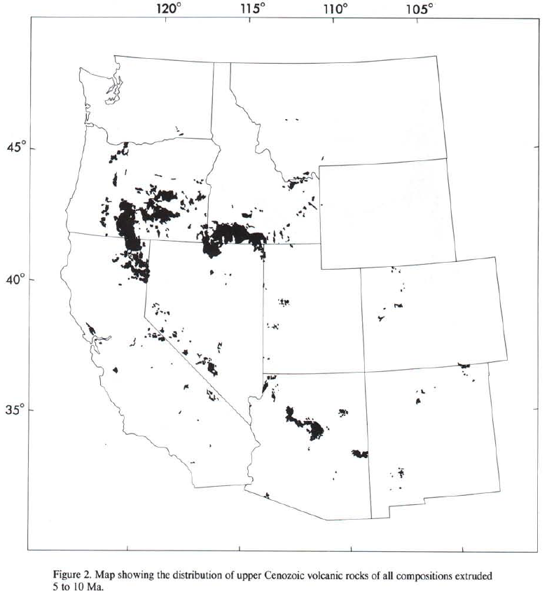
Background Geology 11
5 – 10 Ma
Intermediate rocks are more extensive during this period
Silicic rocks from lava flows and ash flow tuffs are extensive in OR & ID
Volcanic loci became fixed in their respective positions where we currently see them today
Loci exhibit linear features (Cascades & Snake River Plane) sometimes because of faults

Slide 5
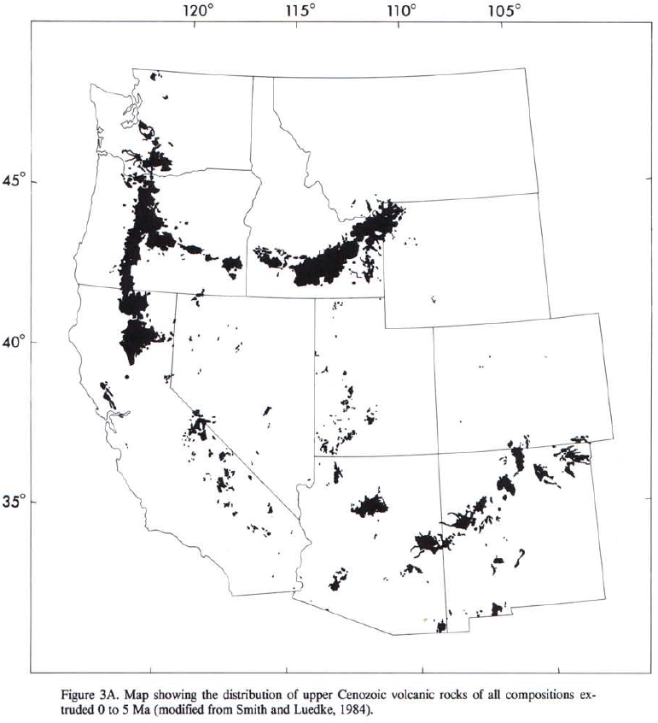
Background Geology 111
0 – 5 Ma
Quaternary volcanism was dominated by extrusive rocks (lava flows of mafic composition) but locally include their intrusive equivalents

Slide 6
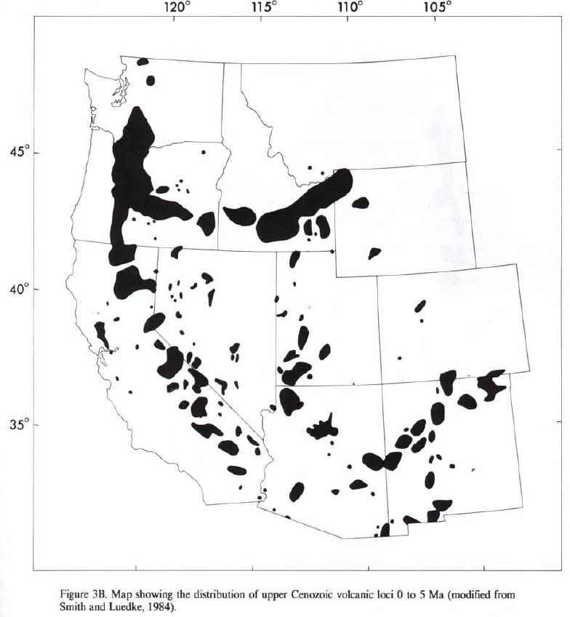
Cascade Region
0 – 5 Ma
Defined by a few widely spaced physiographically striking stratovolcanoes and hundreds of smaller volcanoes
Most of the eruptive activity occurred south of Mt. Rainier within the last 2-3m.y.
Primarily volcanic andesite
Vents show north-trending alignment parallel with the range

Slide 7
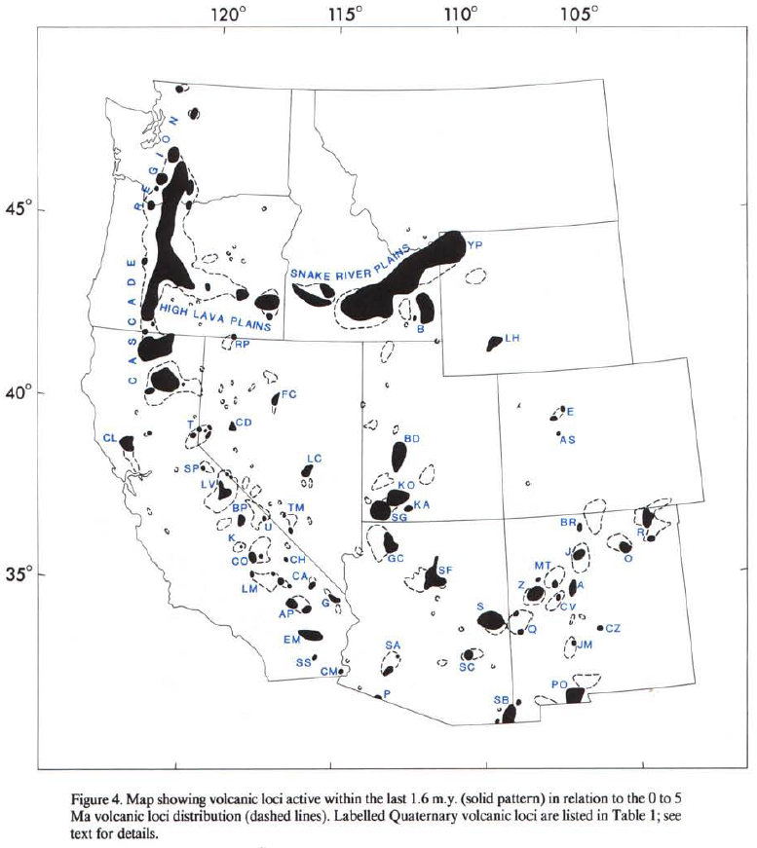
Mt. Baker
Cascade Region
Mt. Rainier
Mt. St. Helens
Mt. Adams
Mt. Hood
0 – 5 Ma
Defined by a few widely spaced physiographically striking stratovolcanoes and hundreds of smaller volcanoes
Most of the eruptive activity occurred south of Mt. Rainier within the last 2-3m.y.
Primarily volcanic andesite
Vents show north-trending alignment parallel with the range
“High Cascades” consists of an elongate Pleistocene volcanic platform composed of tholeiitic basalts and younger basaltic andesite shield volcanoes with cinder cone cores (Sisters etc.)
Mt. Mazama
Mt. Shasta
Mt. Lassen

Slide 8
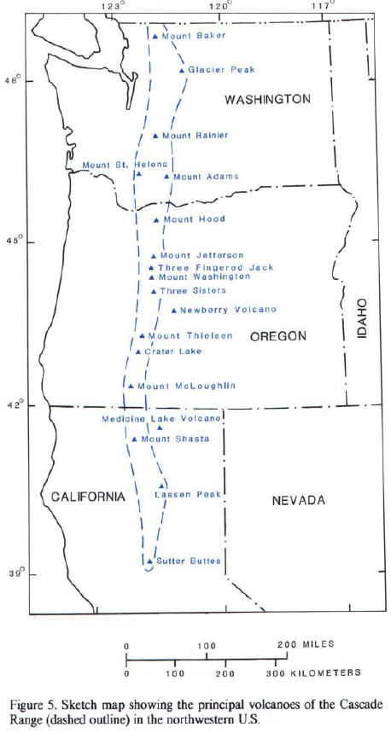
Cascade Region
0 – 5 Ma
Defined by a few widely spaced physiographically striking stratovolcanoes and hundreds of smaller volcanoes
Most of the eruptive activity occurred south of Mt. Rainier within the last 2-3m.y.
Primarily volcanic andesite
Vents show north-trending alignment parallel with the range
“High Cascades” consists of an elongate Pleistocene volcanic platform composed of tholeiitic basalts and younger basaltic andesite shield volcanoes with cinder cone cores (Sisters etc.)

Slide 9
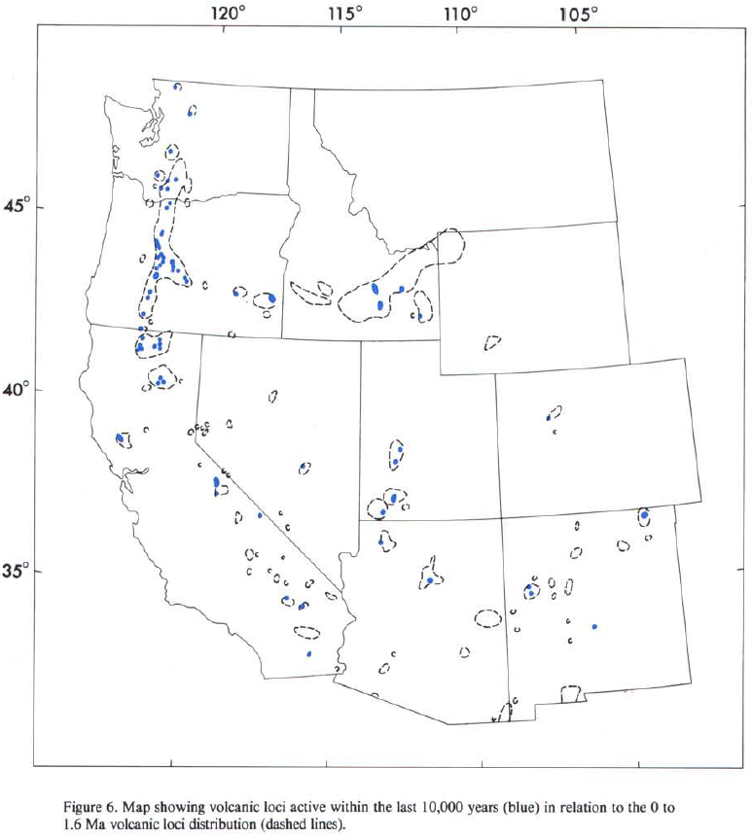
E California – SW Arizona
Medicine Lake Volcano
1ka
0 – 5 Ma
N-NW trending vent alignments
General westward migration of volcanism of predominantly basaltic lavas closely associated with Basin & Range tectonism
Long Valley Caldera
3.2Ma
Coso volcanic field
~3-4Ma
Sentinel-Arlington volcanic field ~1ma

Slide 10
Western Interior Region
Yellowstone Plateau volcanic field <2Ma
<16Ma (Extensional Block Faulting)
Northern margin includes High lava planes in OR & Snake River plane in ID
This region displays volcanism related to extensional northerly trending block faulting
Silicic - mafic volcanism
High Lava plains
<10Ma
Snake River plain
9-14Ma
San Carlos Volcanic Center ~1Ma
San Bernardino Volcanic field ~100Ka

Slide 11
Colorado Plateau
~7-1Ma
Transition between basin & range and Colorado plateau in SW Utah and NW Arizona
Volcanic loci here of basaltic comp are controlled by extensional block faulting
Basaltic volcanism here has migrated eastward onto the Colorado Plateau at a rate of 1cm/yr (Brimhall, 1974)
San Fransisco Volcanic field ~4Ma
Jemez Mtns. Volcanic field ~10Ma
Mt. Taylor Volcanic field ~2.8Ma
Springerville Volcanic field ~3.5Ma

Slide 12
Rio Grande Region
Consists of generally N-S bifurcating faults bound by structural basins
Volcanism extensive in Pliocene but was more restricted to loci in Quaternary
East Boundary
Between Rocky Mtns. & High Plains (pysiographically & geologically)
West Boundary
Between Basin & Range and Colorado Plateau
Brazos locus
Albuquerque volcanic field 190ka
Cerro Verde 300ka
Carrizozo volcanic center 1ka
Potrillo volcanic field
~2.5Ma

Slide 13
Findings
Cascades
Subduction related Stratovolcanoes
E California – W Arizona
Basin & Range related
W Interior
Extensional block faulting
Colorado Plateau
Extensional block faulting
Rio Grande
N-S bifurcating faults
90 volcanic loci have been active in the Quaternary
Quaternary volcanism was dominated by basalt (except the Cascades where is was basalt & andesite)
Silicic volcanism is local, predominantly in the Yellowstone region
Change ~16-17Ma where style of volcanism changed from calcalkaline intermediate comp. volcanic rocks to mafic volcanics

